Slide 1
IBM CAPSTONE PROJECT – The Battle of Neighborhoods: Best place for Brazilians to stay in NY city

Slide 2
Introduction
New York is one of the biggest cities in the world and has a huge number of companies based there. Every year a lot of Brazilians, like me, need to go there to work for some months or to live there. I will make a analysis to find out what is the best neighborhood for a Brazilian stay during some months in New York. I will start by looking for neighborhoods with Brazilian restaurants because I know that would be very hard for me not eating Brazilian food for more than one week. So I prefer to stay around some Brazilian foods. Also, going to Brazilian restaurants I can meet others Brazilians and chat a little bit in Portuguese. Than, I will look for others places that usually Brazilians love like supermarket, gym, bar and coffee. I will also list the best hotels to stay in those neighborhoods.

Slide 3
Data
For this project we need the following data :
New York City data that contains list Boroughs, Neighborhoods along with their latitude and longitude. Data source : https://cocl.us/new_york_dataset Description : This data set contains the required information. And we will use this data set to explore various neighborhoods of new york city.
Brazilian restaurants in each neighborhood of new york city. Data source : Fousquare API Description : By using this api we will get all the venues in each neighborhood. We can filter these venues to get only brazilian restaurants.
Hotel list with ratings Data source : Fousquare API Description : By using this api we will get all hotels around neighborhood with rate.

Slide 4
Solution
First we checked where we have Brazilian restaurants in New York city and found out that most of them are in Queens Borough and only 3 in Manhattan.
Then we analyzed each Neighborhood in Queens Borough getting the top 100 venues to all the neighborhoods in a radius of 500 meters.
After that we clustered neighborhoods using k-means clustering model 3 clusters to check how the neighborhoods in each cluster were similar to each other in terms of the features included in the dataset.

Slide 5
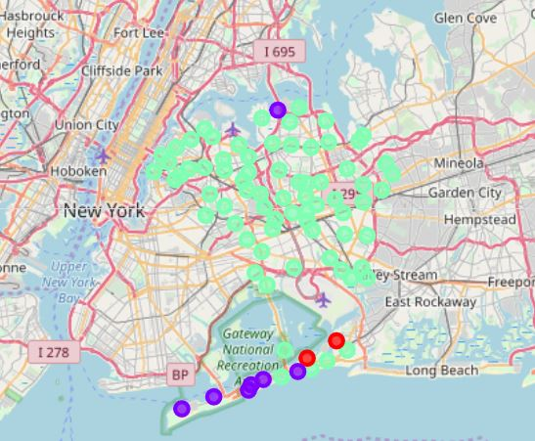
K-Means clustering

Slide 6
Discussion/ Conclusion:
Doing this analysis we found out that Queens Borough have the most of Brazilian restaurants. So we analyzed each neighborhood in Queens to know if any of them would be a good place for Brazilians stay for some months or even leave in New York city.
We clustered the neighborhoods in Queens on 3 clusters to check how similar were them.
We found out that most of neighborhoods in cluster 3 have a lot of restaurants and others places that Brazilians love like Gyms, Bars, Supermarkets, Parks, Coffees and there are public transportation available.
Each person can check the list of venues for each neighborhood and decide what would be the best one to stay. I decided to stay in Hunters Point or Long Island City, because both neighborhoods are similiar and have good hotels, with good rates.

